Slide 1
ENHANCING LEUKEMIA DETECTION WITH MACHINE LEARNING AND STATISTICAL ANALYSIS
Dr.K.S.Karunya ¹, Deepaneesh R V ² , Sanjay Saravanan P ³
Assistant Professor¹, PG Students^{2,3}
Department of Statistics, PSG College of Arts & Science,
Coimbatore,Tamil Nadu, India

Slide 2
INTRODUCTION
Leukemia is a cancer that affects the blood and bone marrow, caused by the uncontrolled production of abnormal white blood cells. These cells multiply excessively, crowding out healthy blood cells necessary for proper bodily function. This global health issue impacts all ages, with certain types more common in specific age groups. Early detection and accurate diagnosis are crucial for effective treatment and better recovery. Advances in medical research have incorporated machine learning techniques in leukemia diagnosis, prognosis, and treatment planning, enhancing accuracy and efficiency.
Predictive modeling in leukemia research uses machine learning to analyze patient data, improving diagnosis, prognosis, and treatment responses. By examining blood test results, genetic markers, and symptoms, these models facilitate early detection and assess disease progression. They also refine predictions using patient histories and identify those at higher risk for complications, enabling timely interventions. Overall, this approach enhances leukemia diagnosis, treatment optimization, and patient care.
In this paper, machine learning and statistical analysis methods are used to predict the leukemia status in a patient.

Slide 3
OBJECTIVES
To develop highly optimized statistical and machine learning models by fine-tuning hyperparameters through a looping method for accurate leukemia prediction.
To identify the most effective model by evaluating accuracy and determining the one with the highest predictive performance.
To determine key variables influencing leukemia status by analyzing feature importance or model coefficients from the best-selected model..
DATA SOURCE
The dataset for this study was sourced from an open-source repository on GitHub. It was refined to include only high-quality responses, resulting in 402 records. Non-essential variables, such as 'Country' and 'Patient ID,' were removed to focus on relevant medical and demographic factors for leukemia prediction. The data was also filtered by age categories to target the most relevant patient groups. This refined dataset serves as the foundation for the machine learning models and statistical analysis.

Slide 4
LITERATURE REVIEW
The article "Blinatumomab Boosts Chemotherapy as Initial Treatment for Some Kids with ALL" by Carmen Phillips (2025) highlights that adding blinatumomab to standard chemotherapy significantly improves disease-free survival in children with standard-risk B-cell acute lymphoblastic leukemia (ALL). A study with over 1,400 participants found a 96% disease-free survival rate after 2.5 years with both treatments, versus 88% with chemotherapy alone. With minimal side effects and FDA approval in June 2024, blinatumomab may become a new standard treatment, though its 28-day infusion may limit accessibility.
The study "Leukemia Incidence Trends (1990-2017)" by Ying Dong et al. (2020) shows a rise in total leukemia cases from 354,500 to 518,500, despite a 0.43% annual decline in the age-standardized incidence rate (ASIR). Acute lymphoblastic leukemia (ALL) cases increased, chronic lymphocytic leukemia (CLL) cases more than doubled, and acute myeloid leukemia (AML) cases rose, while chronic myeloid leukemia (CML) ASIR fell. These trends signal significant public health concerns.
Chennamadhavuni et al. (2023) describe leukemia as a blood cancer characterized by abnormal white blood cell production, classified into acute and chronic forms. Chemotherapy is the main treatment, and an interprofessional healthcare team is crucial for improving outcomes.

Slide 5
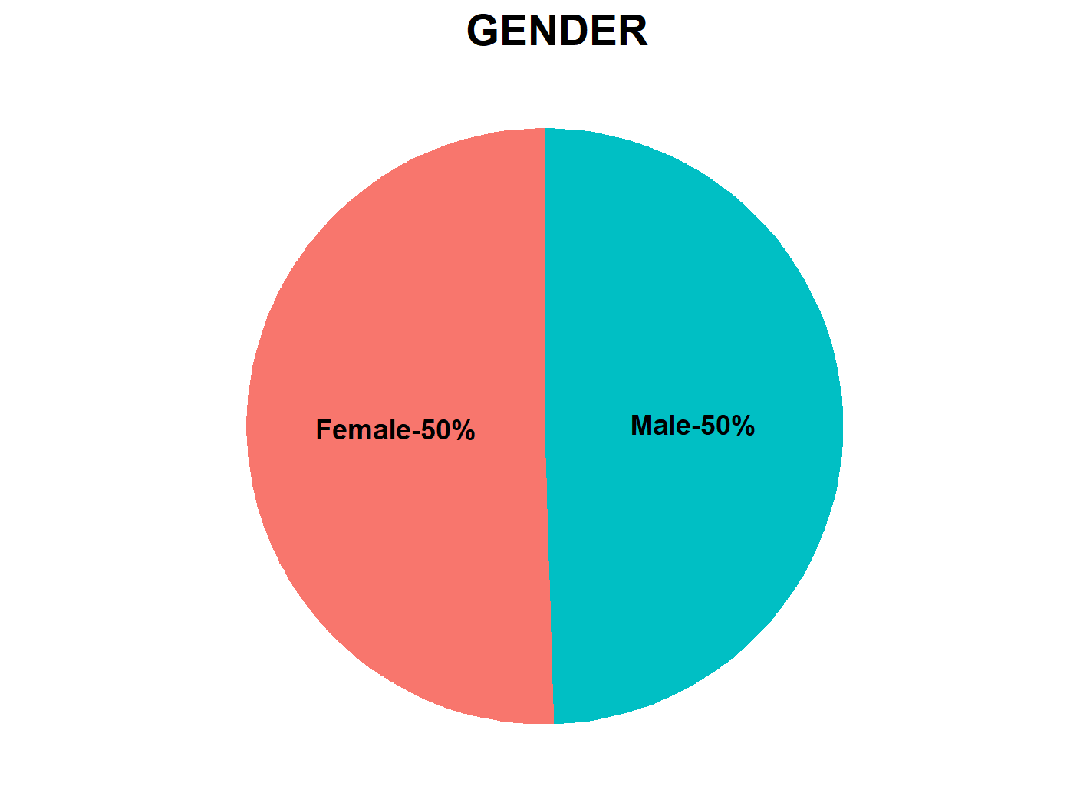
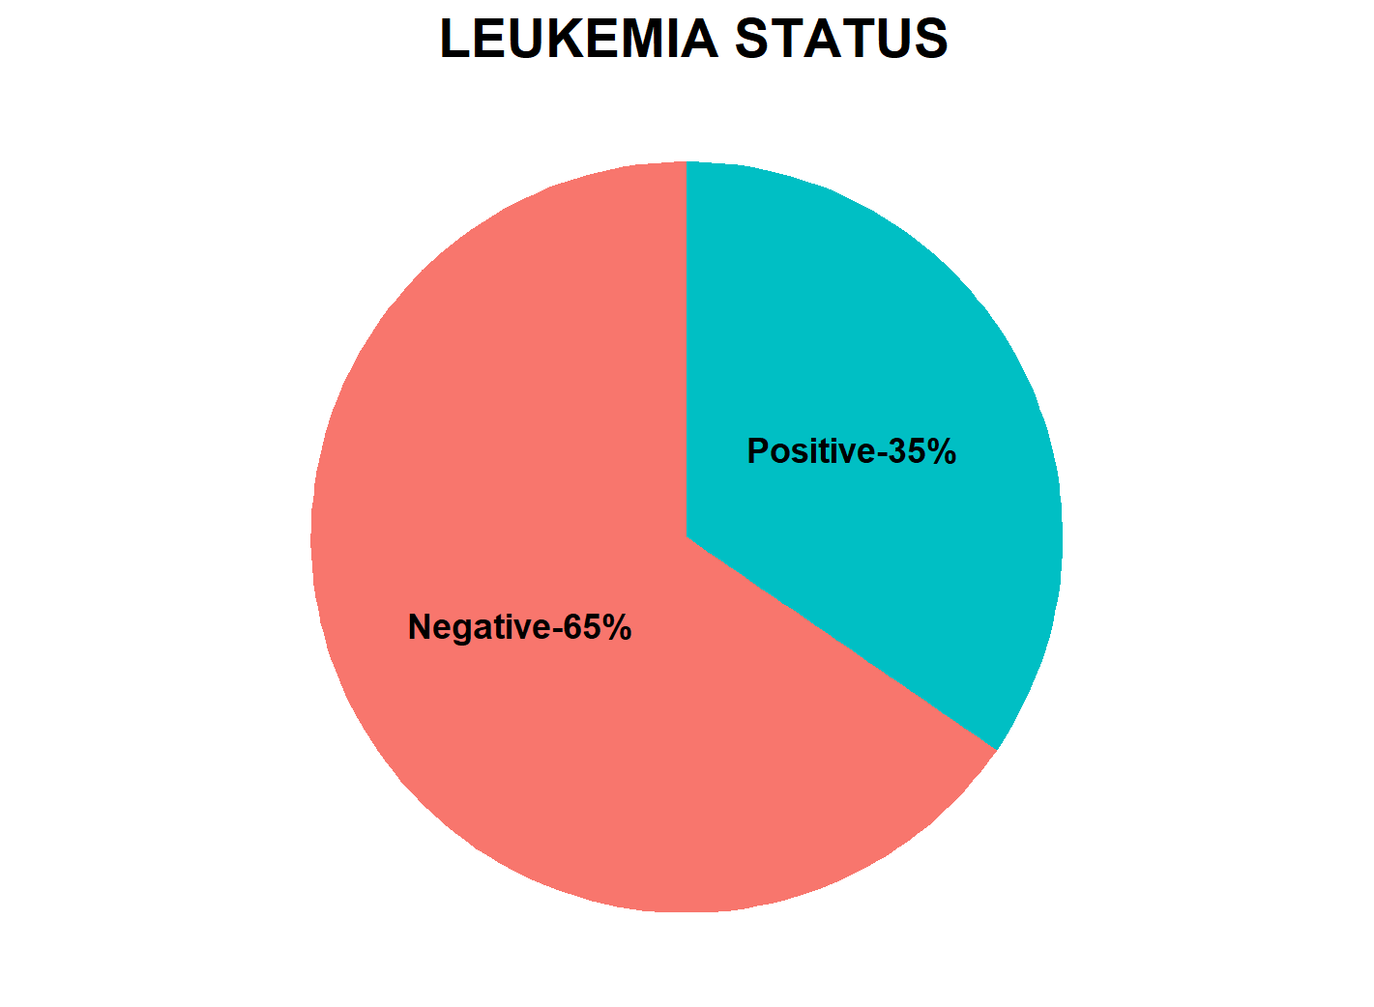
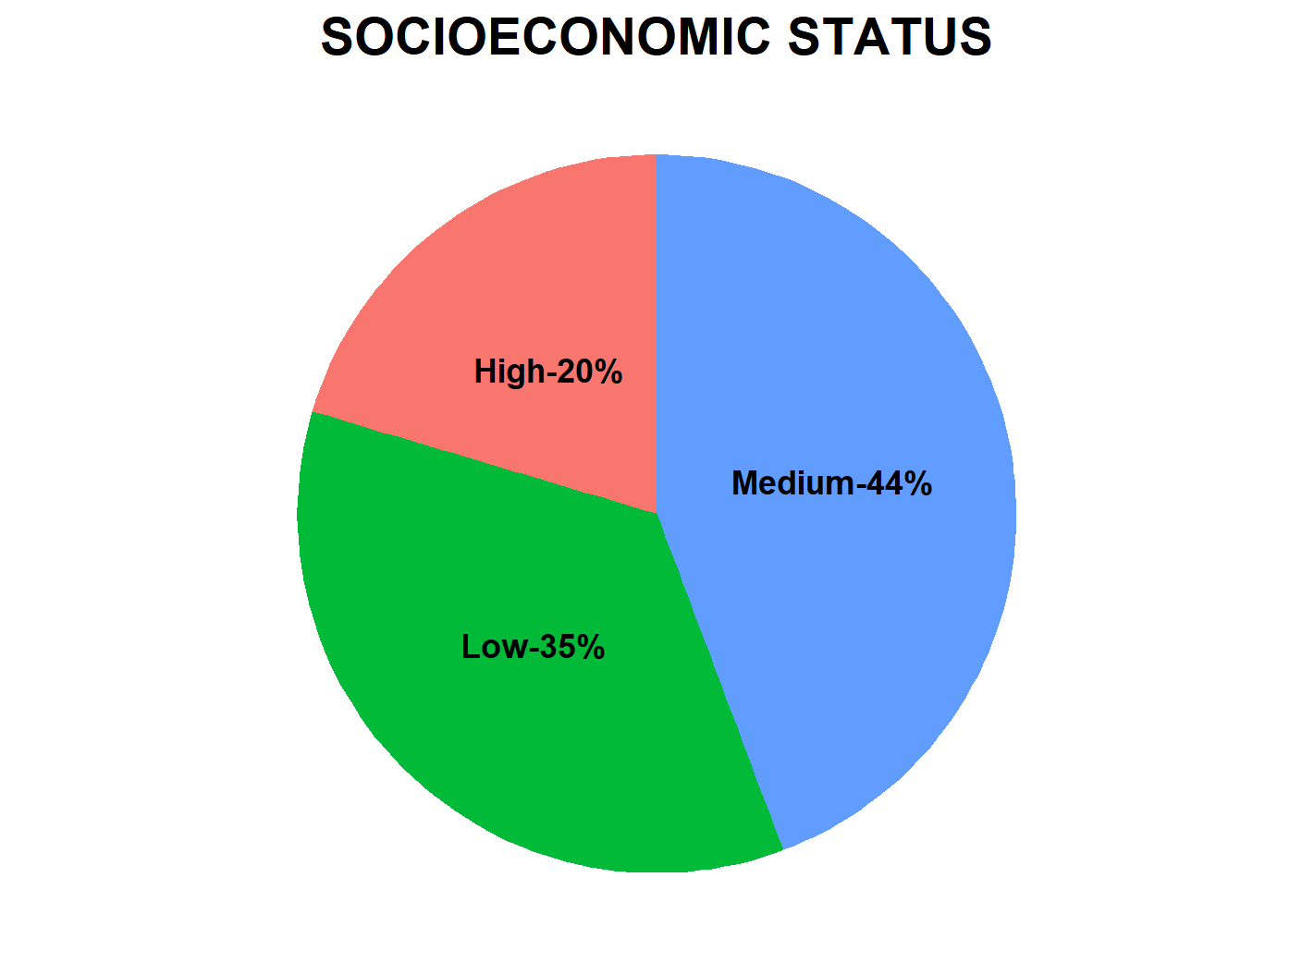
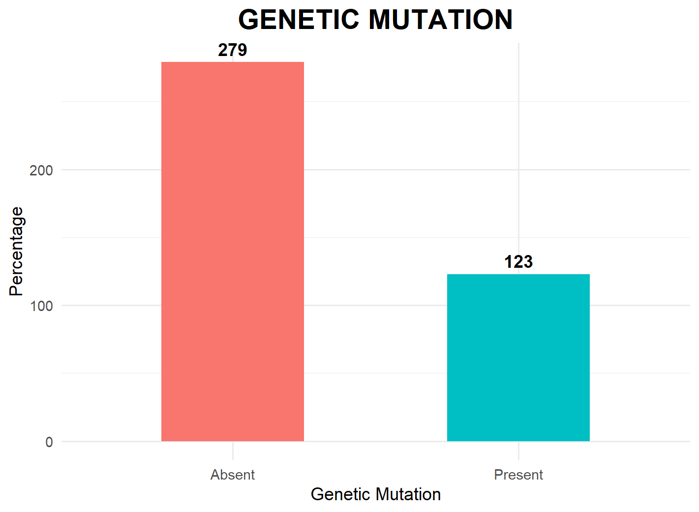
ANALYSIS & INTERPRETATION

Slide 6
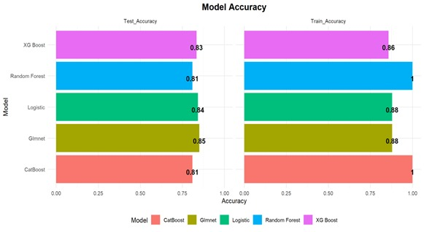
MODEL EVALUATION
Model Summary
Model | Train_Accuracy | Test_Accuracy
Logistic | 0.8790 | 0.8430
CatBoost | 1.0000 | 0.8099
XG Boost | 0.8577 | 0.8347
Random Forest | 1.0000 | 0.8099
Glmnet | 0.8790 | 0.8512
By comparing the table above, logistic regression is the best among other machine learning models. However, logistic regression includes all variables in a dataset, so we are moving to GLMNET, which helps to shrink other variables.

Slide 7
LOGISTIC REGRESSION
Training set
Testing set
Accuracy | 0.8790
95% CI (Lower) | 0.8350
95% CI (Upper) | 0.9147
No Information Rate | 0.6548
P-Value (Acc > NIR) | 0.0000
Kappa | 0.7310
Accuracy | 0.8430
95% CI (Lower) | 0.7657
95% CI (Upper) | 0.9027
No Information Rate | 0.6529
P-Value (Acc > NIR) | 0.0000
Kappa | 0.6477
GENERALISED LINEAR MODEL
Parameters
glmnet(x = x_train, y = y_train)
family = "binomial"
alpha = 0.1
lambda = 0.01303
Training set
Testing set
Accuracy | 0.879
95% CI (Lower) | 0.835
95% CI (Upper) | 0.9147
No Information Rate | 0.6548
P-Value (Acc > NIR) | 0.0000
Kappa | 0.7284
Accuracy | 0.8512
95% CI (Lower) | 0.7751
95% CI (Upper) | 0.9094
No Information Rate | 0.6529
P-Value (Acc > NIR) | 0.0000
Kappa | 0.6643

Slide 8
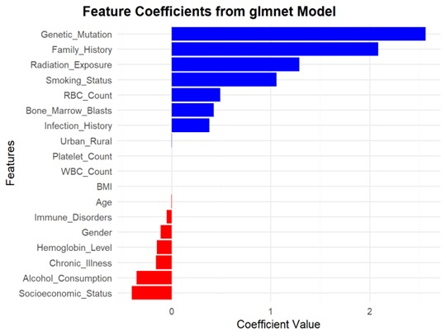
GENERALISED LINEAR MODEL
CO-EFFICIENT OF GENERALIZED LINEAR MODEL
Variable | Estimate |  | Variable | Estimate
Age | -0.002 |  | Smoking_Status | 1.0599
Gender | -0.1094 |  | Alcohol_Consumption | -0.3555
WBC_Count | 0.0003 |  | Radiation_Exposure | 1.2889
RBC_Count | 0.4918 |  | Infection_History | 0.3804
Platelet_Count | 0.0005 |  | BMI | 0
Hemoglobin_Level | -0.147 |  | Chronic_Illness | -0.1575
Bone_Marrow_Blasts | 0.4253 |  | Immune_Disorders | -0.0507
Genetic_Mutation | 2.5637 |  | Socioeconomic_Status | -0.4009
Family_History | 2.0862 |  | Urban_Rural | 0.0022
By comparing the table above, it is clear that genetic mutation, family history, and RBC count are important variables. Additionally, the likelihood of developing leukemia is higher in males than in females. There is no specific age limit or BMI requirement associated with this risk.

Slide 9
CONCLUSION
Leukemia risk is influenced by genetic, lifestyle, and environmental factors.
Genetic mutations and a family history of leukemia are strong predictors.
High white blood cell counts and increased bone marrow blasts indicate blood and bone marrow abnormalities.
Lifestyle factors like smoking and radiation exposure also elevate risk, while middle-income individuals may experience a protective effect, though the reasons are unclear.
Despite analysing factors like BMI, platelet count, and alcohol consumption, most did not show significant impacts on leukemia prediction.
Early identification through screenings and genetic testing can improve disease management and survival rates.
A comprehensive approach, including medical monitoring and lifestyle changes, is essential to reduce leukemia incidence and enhance patient outcomes.

Slide 10
REFERENCE
Brereton, R. G., & Lloyd, G. R. (2014). Partial least squares discriminant analysis: Taking the magic away. Journal of Chemometrics, 28(4), 213–225.
Chennamadhavuni, A., Lyengar, V., & Al-Kali, A. (2023). Leukemia. StatPearls Publishing.
Davis, A. S., Viera, A. J., & Mead, M. D. (2014). Leukemia: An overview for primary care. American Family Physician, 89(9), 731-738.
Dong, Y., Shi, O., Zeng, Q., Lu, X., Wang, W., Li, Y., & Zhang, L. (2020). Leukemia incidence trends at the global, regional, and national level between 1990 and 2017. Frontiers in Oncology, 10, 598072.
Hedegaard, M., Matthäus, C., Hassing, S., Krafft, C., Diem, M., & Popp, J. (2011). Spectral unmixing and clustering algorithms for assessment of single cells by Raman.

